Slide 1

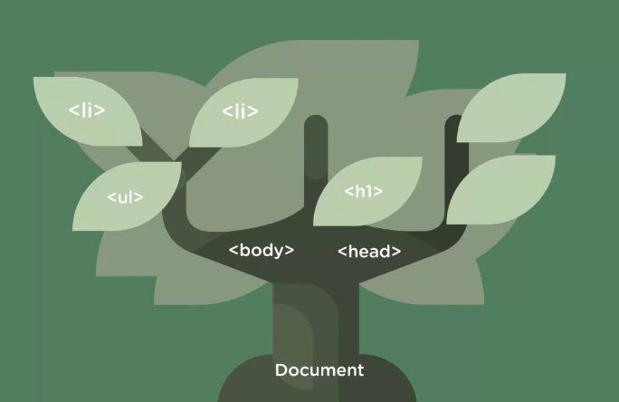
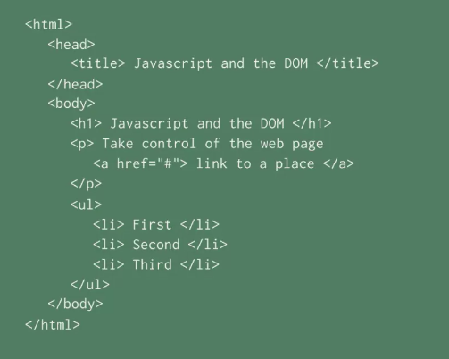
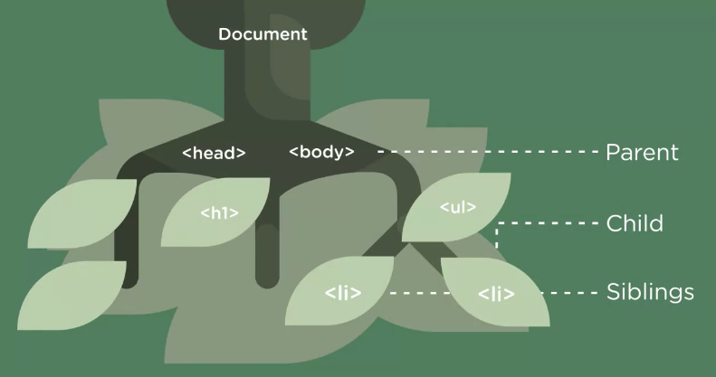
Notes:
The DOM is a representation of a webpage that JavaScript can use.
the DOM is a map of a webpage that JavaScript can use. Now, unlike a map the DOM is a live entity, so changes that JavaScript makes to the DOM alter the webpage.

Slide 2
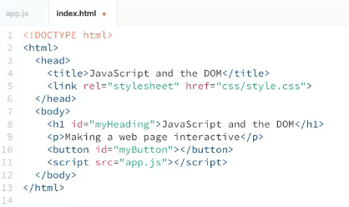
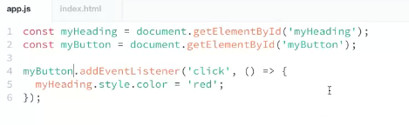
<!DOCTYPE html>
<html>
<head>
<title>JavaScript and the DOM</title>
<link rel="stylesheet" href="css/style.css">
</head>
<body>
<h1 id="myHeading">JavaScript and the DOM</h1>
<p>Making a web page interactive</p>
<script src="app.js"></script>
</body>
</html>
const myHeading = document.getElementById('myHeading');
myHeading.addEventListener('click', () => {
myHeading.style.color = 'red';
});

Slide 3

<!DOCTYPE html>
<html>
<head>
<title>JavaScript and the DOM</title>
<link rel="stylesheet" href="css/style.css">
</head>
<body>
<h1 id="myHeading">JavaScript and the DOM</h1>
<p>Making a web page interactive</p>
<input type="text" id="myTextInput">
<button id="myButton">Change headline color</button>
<script src="app.js"></script>
</body>
</html>
const myHeading = document.getElementById('myHeading');
const myButton = document.getElementById('myButton');
const myTextInput = document.getElementById('myTextInput');
myButton.addEventListener('click', () => {
myHeading.style.color = myTextInput.value;
});

Slide 4

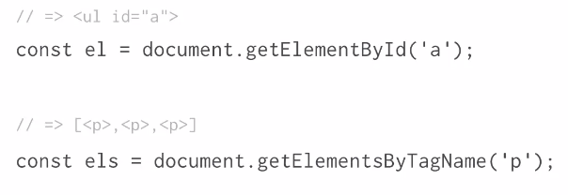
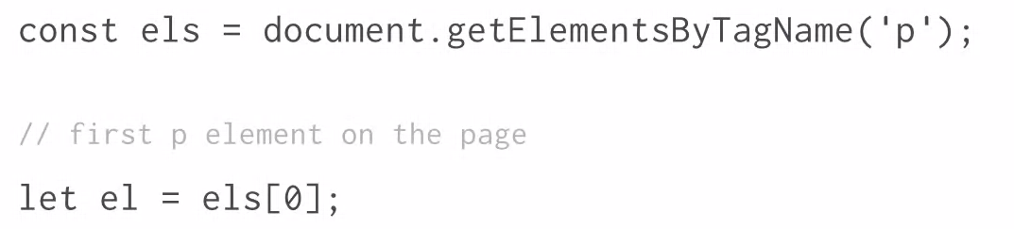
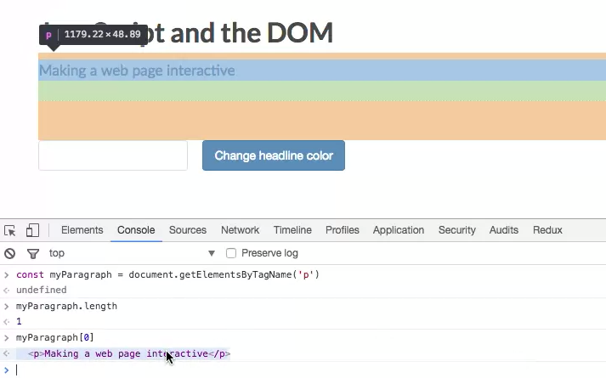
collections

Slide 5
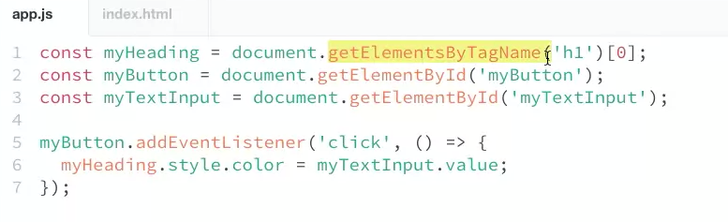

Slide 6
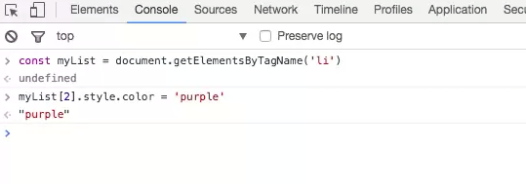
<!DOCTYPE html>
<html>
<head>
<title>JavaScript and the DOM</title>
<link rel="stylesheet" href="css/style.css">
</head>
<body>
<h1 id="myHeading">JavaScript and the DOM</h1>
<p>Making a web page interactive</p>
<p>Things that are purple:</p>
<ul>
<li>grapes</li>
<li>amethyst</li>
<li>lavender</li>
<li>plums</li>
</ul>
<script src="app.js"></script>
</body>
</html>
How to change all of the list items’ colours?

